Slide 1
Preventing Heat
Illnesses
Notes:
Thank you for including me…
My background – over 25 years of commercial Property and Casualty insurance experience, specializing in marketing, product development, and the utilization of client-facing technologies.
Began career with Willis, then was with Sedgwick which became Marsh, then spent the last 15 years with WGA and came into Gallagher as a merger partner in 2015.
Beyond all my marketing years, I was a producer while at Marsh and when I started at WGA, making me uniquely qualified to know what it takes for all of you to get the kind of opportunities I want to work on with you.

Slide 2
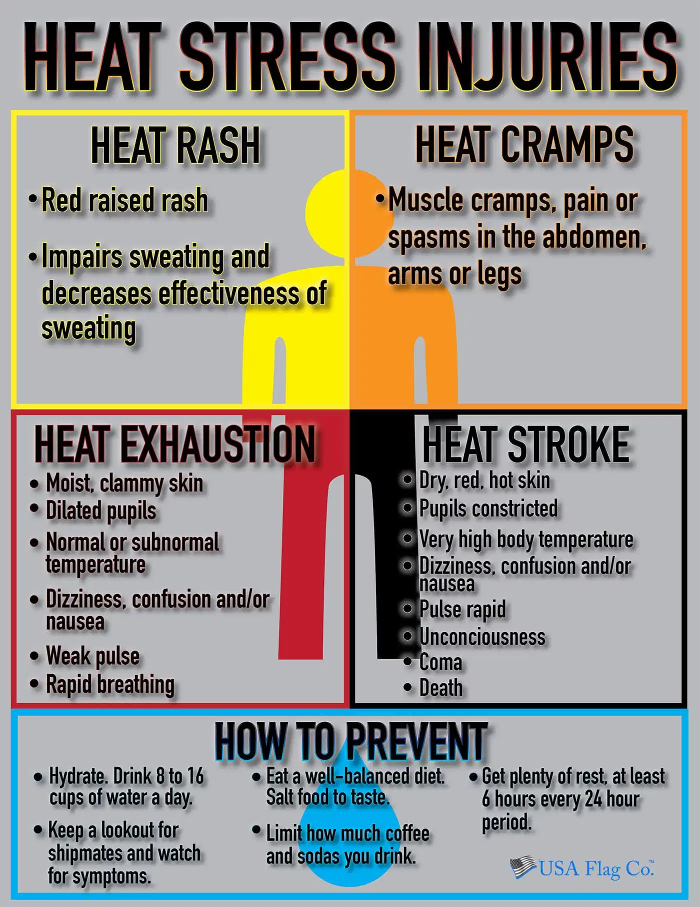
HEAT STRESS

Slide 3
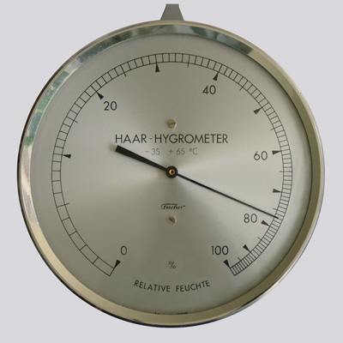
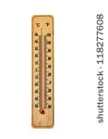
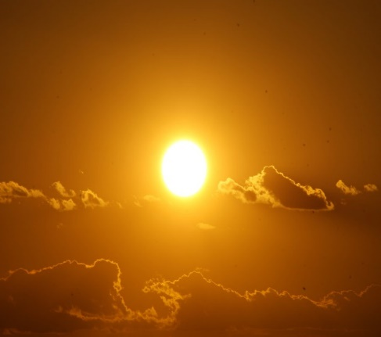
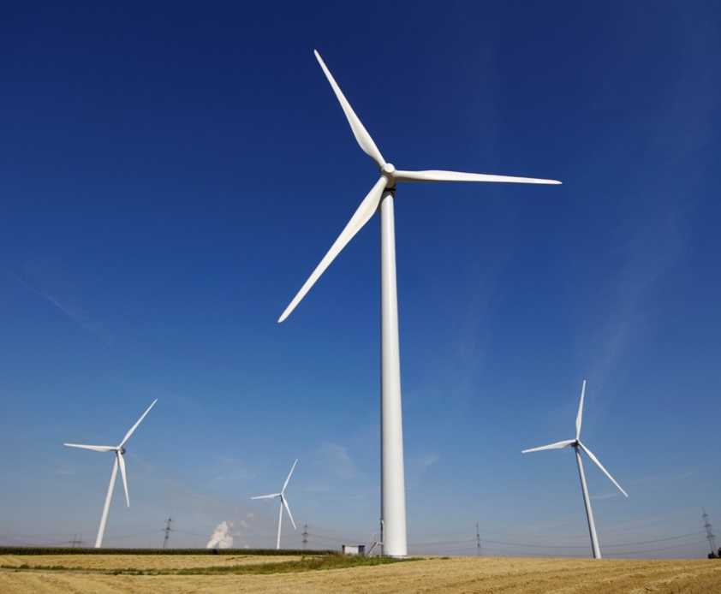
Contributing Factors
Temperature
Humidity
Radiant Heat
Air Velocity
Temperature is not the only indicator!!

Slide 4
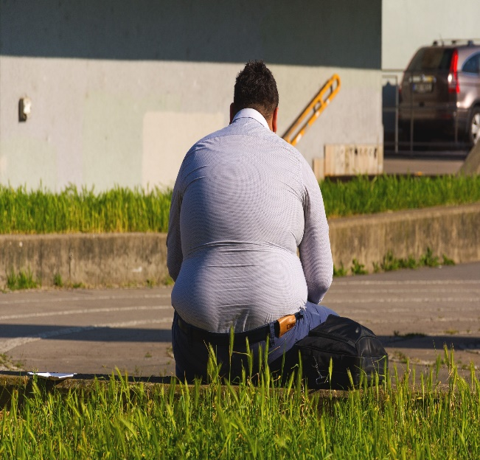
Contributing Factors – cont’d
Personal Factors
Age
Weight
Fitness
Acclimatization – increased tolerance to heat that comes from working in a hot environment for a period of 1-2 weeks.

Slide 5
Heat Disorders
Heat Rash
Heat Cramps
Heat Exhaustion
Heat Stroke

Slide 6
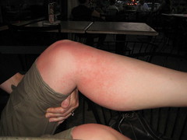
Heat Disorders
Heat Rash
Also known as “Prickly Heat.”
Occurs when sweat cannot freely evaporate from the skin and sweat ducts become plugged. This inflammation can cause a red rash.
Can be prevented by wearing clothes that allow sweat to evaporate as well as bathing regularly and drying the skin.

Slide 7
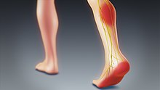
Heat Disorders
Heat Cramps
Cramps in the arms, legs, or abdomen
Occur in individuals who sweat profusely then drink large quantities of water, but do not adequately replace the body’s salt loss.
To prevent, ensure that salts are replaced during and after heavy sweating.

Slide 8
Heat Disorders
Heat Exhaustion – Cause
Mild form of shock caused when the circulatory system begins to fail as a result of the body’s inadequate effort to give off excessive heat.
Although not an immediate threat to life, if not properly treated, could evolve into heat stroke.

Slide 9
Heat Disorders
Heat Exhaustion – Symptoms
Skin is clammy and moist
Extreme weakness or fatigue
Nausea
Headache
Complexion pale or flushed
Body temperature normal or slightly elevated

Slide 10
Heat Disorders
Heat Exhaustion - Treatment
Do not leave the person alone.
Move to a cool place to rest.
Drink water or electrolyte fluids.
Treat for shock, if necessary.
If unconscious, fails to recover rapidly, has other injuries, or has a history of medical problems, seek medical attention.

Slide 11
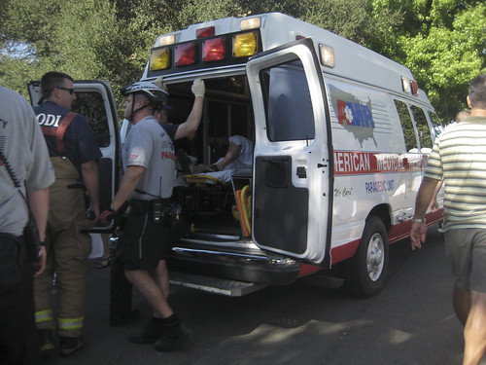
Heat Disorders
Heat Stroke - Cause
Severe and sometimes fatal condition resulting from the failure of the body to regulate its core temperature.
The body’s normal cooling mechanisms stop functioning, sweating stops.
True medical emergency requiring immediate medical attention.

Slide 12
Heat Disorders
Heat Stroke – Symptoms
Stop Sweating
Rapid Pulse
Mental Confusion
Loss of Consciousness
Convulsions
Body Temperature > 105
Hot, dry skin
Can die unless treated promptly

Slide 13
Heat Disorders
Heat Stroke – Treatment
Call 911
Remove victim to a cool area
Soak clothing with cool water and fan vigorously to increase cooling
Monitor vital signs

Slide 14
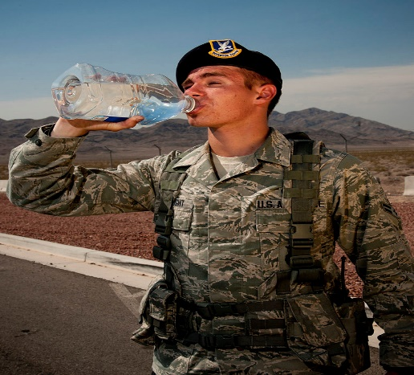
Prevention Methods
Acclimatization
Work in pairs
Drink plenty of cool water or electrolyte replacement fluids even if not thirsty. (One small cup every 15-20 minutes)
Be able to recognize early signs & symptoms of heat-induced illness and take appropriate action to prevent serious heat disorders.
Schedule most strenuous work during the coolest times of the day.

Slide 15
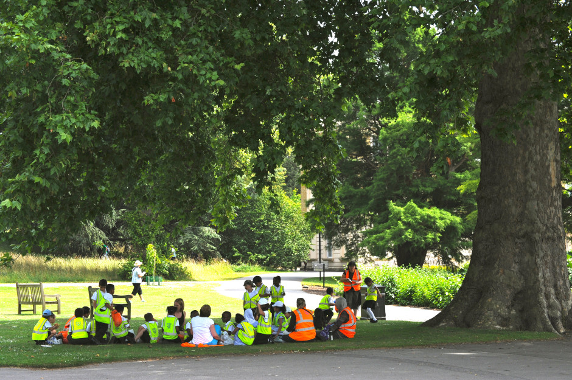
Prevention Methods
Spend as little time as possible in direct sunlight.
Take frequent breaks in cool, shaded areas.
Wear light, loose fitting, clothing.
Avoid caffeine, which can make the body lose water.
Rotate workers in and out of hot areas if possible.

